Slide 1
Predicting House Prices using Machine Learning
Phase 4
building the house price prediction model by
Feature selection
Model training
Evaluation.

Slide 2
introduction
The machine learning model is given the test data but without the price of the properties in order to predict the price for them given the various features for the properties.
The predicted price is then compared to the an the case of house price prediction, we can use historical data on various features of a house, such as its location, size, and amenities, to train a machine-learning model.
Once the model is trained, it can analyze new data on a given house and make a prediction of its market value.ctual price n the case of house price prediction, we can use historical data on various features of a house,
such as its location, size, and amenities, to train a machine-learning model. Once the model is trained, it can analyze new data on a given house and make a prediction of its market value.n the test data.

Slide 3
Basic features selection
Feature Selection is an important technique that is used to handle high-dimensional input data
and overfitting caused by a curse of dimensionality by selecting a relevant feature subset based
on mutual information criterion [36]. Moreover, feature selection has many advantages, such
as improve the prediction performance by reducing dimensionality in the dataset. It speeds up
the learning process and leads to a better understanding of the considered problem. However,
there are many useful methods for feature selection, such as Mutual Information (MI) and
Conditional Mutual Information (CMI) [37]. Mutual information is used for quantifying the
mutual dependence of random variables, and it can be considered as the amount of information
shared by two variables. MI is given as:
𝐼(𝑋; 𝑌) = ∑ ∑ 𝑝(𝑥𝑦)𝑙𝑜𝑔
𝑝(𝑥𝑦)
𝑦 𝑝(𝑥)𝑝(𝑦) 𝑥∈𝑋 ∈𝑌
(12)
Where 𝑥 ∈ 𝑋 and 𝑦 ∈ 𝑌 are the possible value assignments of 𝑋 and 𝑌, and 𝑙𝑜𝑔 i

Slide 4
evaluation
Several evaluation metrics measure the performance of machine learning algorithms such as
Mean Squared Error (MSE), Root Mean Squared Error (RMSE), R-Squared, and Mean
Absolute Error (MAE). However, in this study, the performance of the algorithms is measured
by using RMSE and R-Squared.
Root Mean Square Error (RMSE) is used as an evaluation metric in machine learning to
measure the performance of the model. However, RMSE is similar to the Mean Square Error
(MAE). Where all errors in MAE have the same weight, but RMSE penalises the variance,
which means it gives more weight to the errors that have large absolute values than that have
small absolute values. Therefore, when RMSE and MAE are calculated, RMSE is always
bigger than MAE. RMSE is more sensitive to the errors than MAE; therefore, using RMSE for
measuring the performance is better than MAE [38]. RMSE can be calculated as the square
root of the sum of squared errors

Slide 5
Expression for evalvation
𝑅𝑀𝑆𝐸 = √ ∑ (𝑦𝑖 − 𝑦̂𝑖 ) 𝑛 2 𝑖=1 𝑛 (14) It can be observed from the equation when the sum of squared errors is closer to zero, RMSE is closer to zero. Therefore, when RMSE is zero, it means there are no errors between the actual value 𝑦 and the predicted value 𝑦 ̂.
R-Squared or as known as coefficient determination is a statistical measurement that is used in machine learning to measure how close the data are to the fitted regression line. R-Squared takes the value between 0 and 1. Where 1 indicates the prefect score and 0 is imperfect.
In addition, R-Squared is calculated by measuring the deviations of the observations from their predicted values over the measurement of the deviations of the observations from their mean. R-Squared can be presented as: 𝑅 2 = 1 − ∑ (𝑦𝑖 − 𝑦̂𝑖 ) 2 𝑖 ∑ (𝑦𝑖 − 𝑦̅) 2 𝑖 (15) 18 Where 𝑦 is the model, 𝑦̅ is the mean of the model, and 𝑦 ̂is the prediction model of 𝑦.
It can be observed when the sum of squared errors ∑ (𝑦𝑖 − 𝑦̂𝑖 ) 2 𝑖 Is closer to zero and R-Squared is

Slide 6
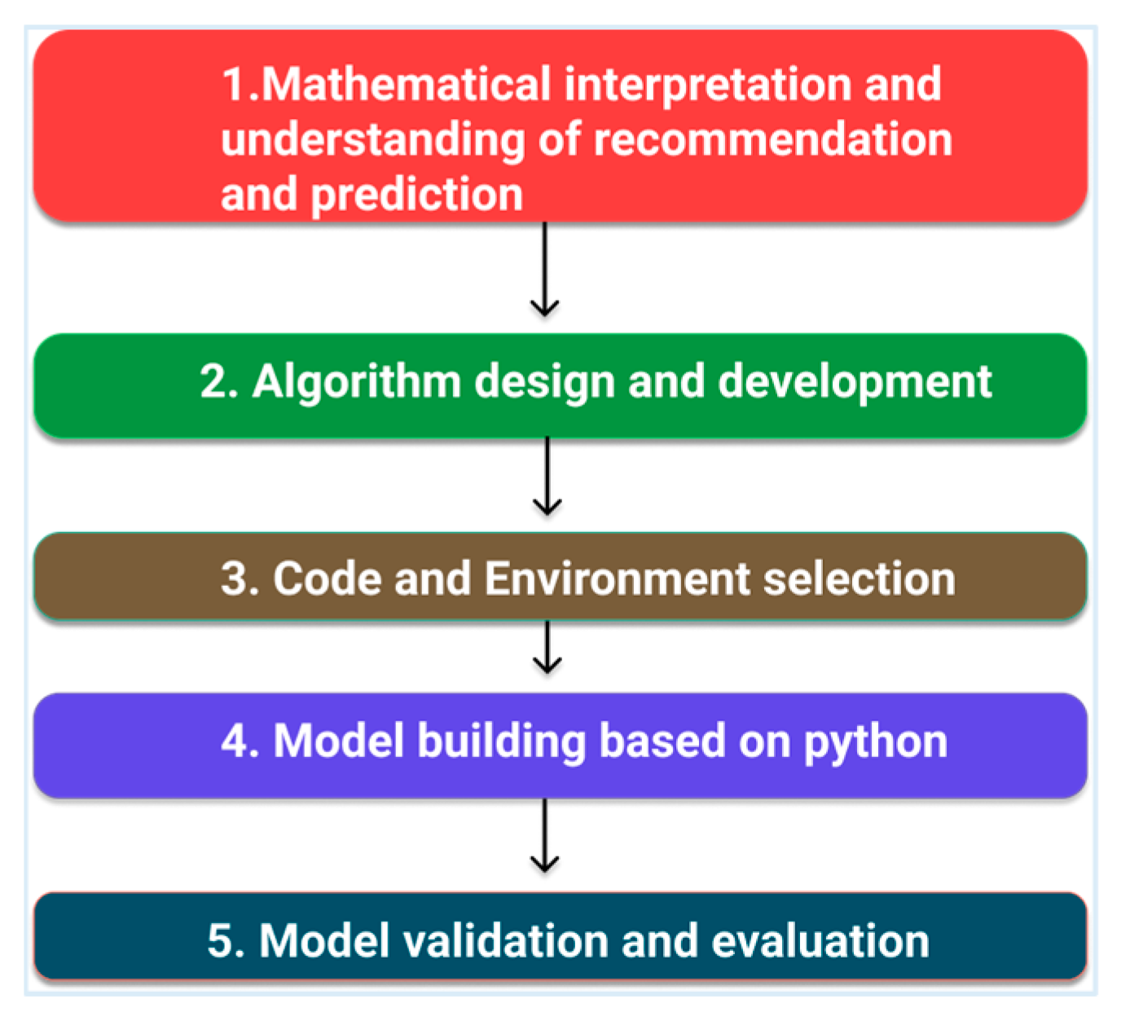
Flow chart

Slide 7
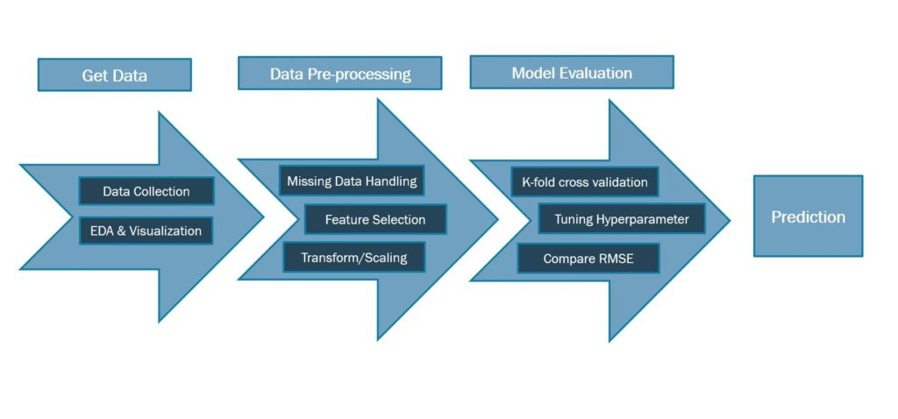
Process step in house pridiction

Slide 8
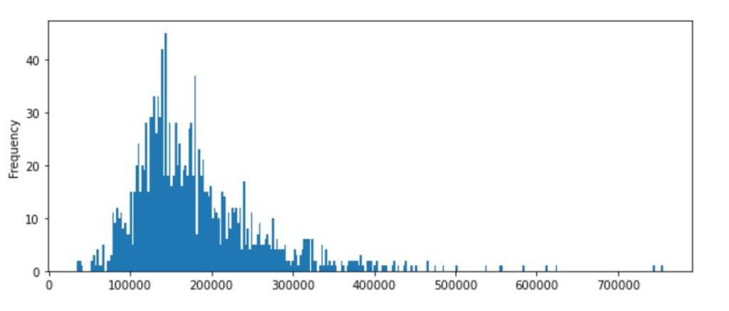
Exploratory Data Analysis
For this dataset, the first step of EDA is to check the distribution of Sale Price on train data-set. It’s observed in the histogram that the data is rightly skewed with a skewness of 1.88 and kurtosis as 6.53 which needs a log-transformation to correct the distribution in feature-engineering step.

Slide 9
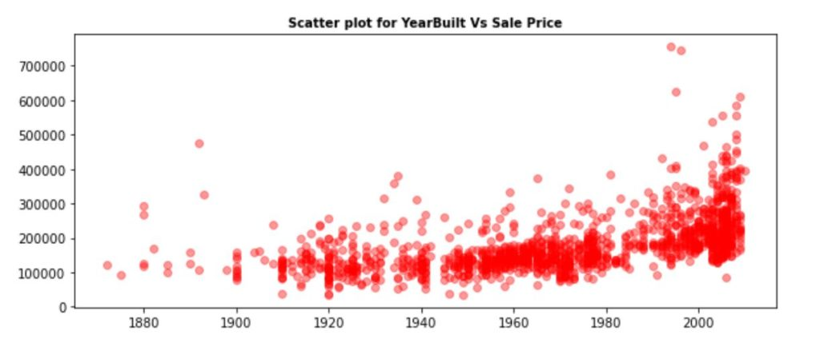
Scatter plot for yaerbuilt vs scale price

Slide 10
SAMPLE CODE
import pandas as pd
import numpy as np
import seaborn as sns
import matplotlib.pyplot as plt
%matplotlib inline
HouseDF = pd.read_csv('USA_Housing.csv')
HouseDF.head()
HouseDF=HouseDF.reset_index()
HouseDF.head()
HouseDF.info()
HouseDF.describe()
HouseDF.columns
sns.pairplot(House
from sklearn.model_selection import train_test_split
X_train, X_test, y_train, y_test = train_test_split(X, y,test_size=0.4,random_state=101)
from sklearn.linear_model import minmaxscaler
lm = minmaxscaler(feature_range=(0,1))
lm.fit_transform(X_train,y_train)
print(lm.intercept_)
coeff_df = pd.DataFrame(lm.coef_,X.columns,columns=['Coefficient’])
coeff_d

Slide 11
.
from keras.layersimport Dense,Dropout,LSTM
from keras.models import Sequential
model.add(LSTM(units = 50,activation = 'relu',return_sequences = True,in
model = Sequential()
model.add(Dropout(0.4))
model.add(LSTM(units = 120,activation = 'relu'))
model.add(Dropout(0.5))
model.add(Dense(units = 1))
model.compile(optimizer='adam', loss = 'mean_squared_error’)
model.fit(x_train, y_train,epochs=50)
print(lm.intercept_)
coeff_df = pd.DataFrame(lm.coef_,X.columns,columns=['Coefficient’])
coeff_df
predictions = lm.predict(X_test)
scale sns.distplot((y_test-predictions),bins=50

Slide 12
‘
plt.figure(figsize=(12,6))
plt.plot(y_test,'b',label = 'Original Price')
plt.plot(y_predicted,'r',label = 'Predicted Price')
plt.xlabel('Time')
plt.ylabel('Price')
plt.legend()
plt.show()
from sklearn import metrics
print('MAE:', metrics.mean_absolute_error(y_test, predictions))
print('MSE:', metrics.mean_squared_error(y_test, predictions))
print('RMSE:', np.sqrt(metrics.mean_squared_error(y_test, predictions)))

Slide 13
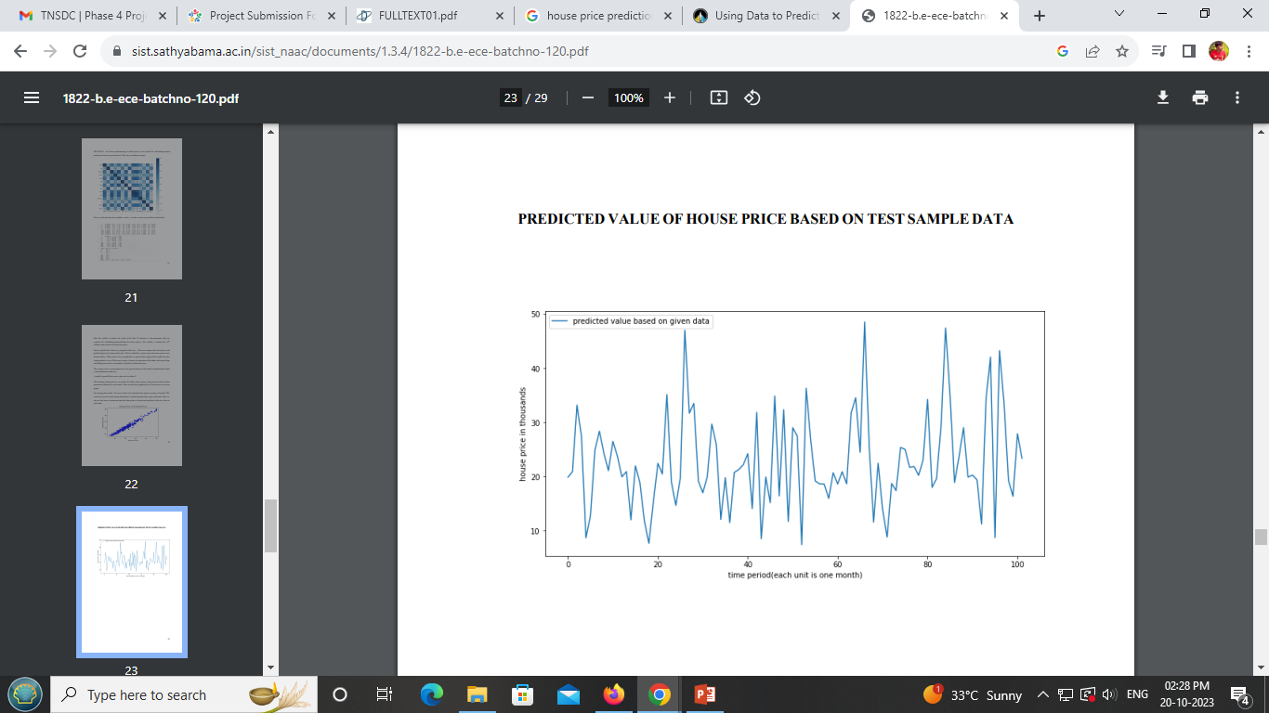
PREDICTED VALUE OF HOUSE PRICE BASED ON TEST SAMPLE DATA

Slide 14
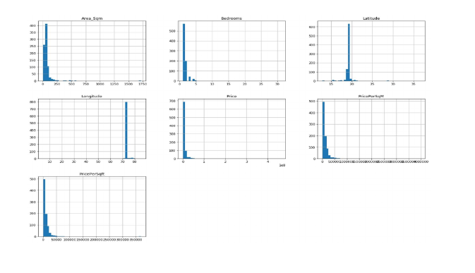
Data Visualization
Data visualization is the graphical representation of information and data. By
using visual elements like charts, graphs, and maps, data visualization tools provide an
accessible way to see and understand trends, outliers, and patterns in data. In the
world of Big Data, data visualization tools and technologies are essential to analyse
massive amounts of information and make data-driven decisio

Slide 15
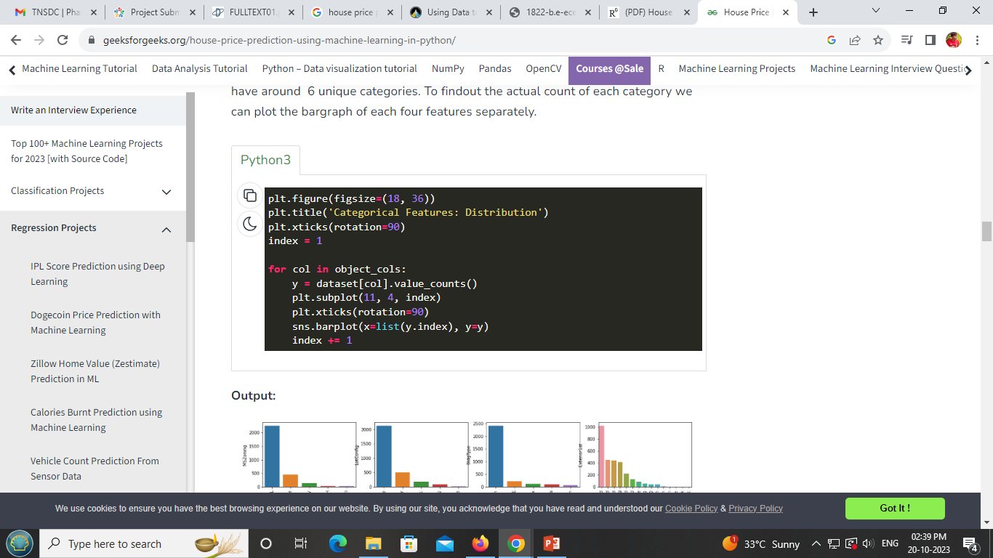
program

Slide 16
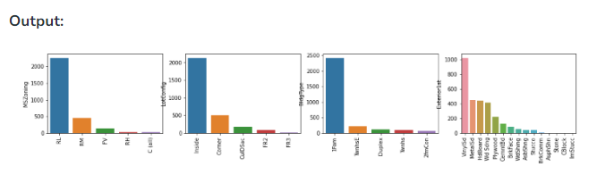
.

Slide 17
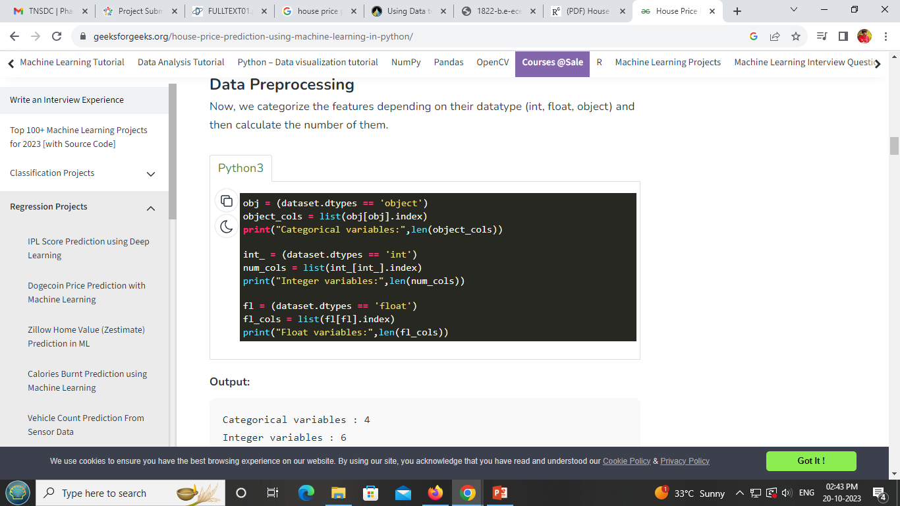
Data processing

Slide 18
output
Categorical variables : 4
Integer variables : 6
Float variables : 3

Slide 19
conclusion
Thus the machine learning model to predict the house price based ongiven dataset is executed
successfully using xg regressor (a upgraded/slighted boosted form of regular linear regression,
this gives lesser error). This model further helps people understand whether this place is more
suited for them based on heatmap correlation. It also helps people looking to sell a house at
best time for greater profit. Any house price in any location can be predicted with minimum
errorby giving appropriate dataset

Slide 20
Project submitted by
Sivananthan R
822421106066

Slide 21

.

